Slide 1
COLLABORATION, CONTENT AND MODEL-BASED RECOMMENDER SYSTEMS EVALUATION MIHAILO JOKSIMOVIĆ, 2017/430059
UNIVERZITET SINGIDUNUM
DEPARTMAN ZA MASTER STUDIJE

Slide 2
Abstract
Evaluate various categories of Recommender Systems
Document the Accuracy and other relevant metrics

Slide 3
Collaborative filtering

Slide 4
Content-based systems

Slide 5
Singular Value Decomposition (SVD)

Slide 6
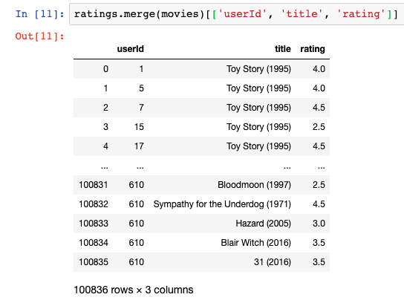
Dataset
Publicly available MovieLens Dataset
600 users, 9.700 movies and 100k ratings
Ratings range [0.5, 5]

Slide 7
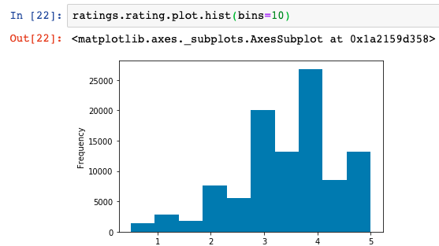
Dataset

Slide 8
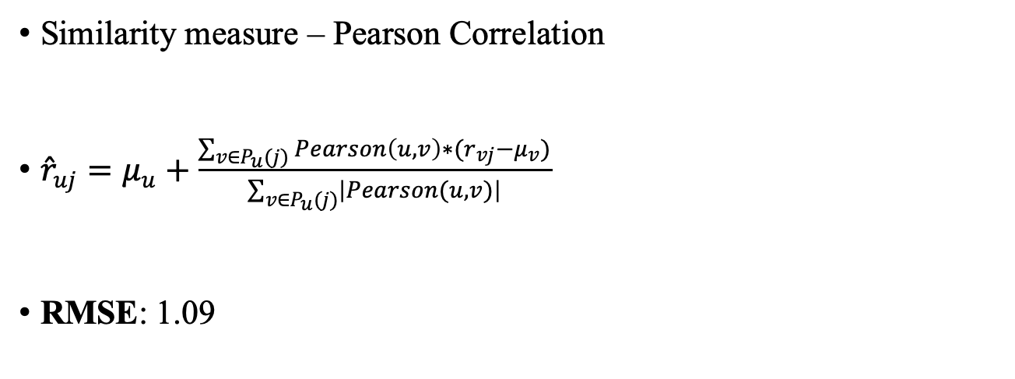
1st Case – User-based c.f.
Similarity measure – Pearson Correlation
${\hat{r}}_{uj}=μ_{u}+\frac{\sum_{v∈P_{u}(j)}{Pearson\left(u, v\right)∗(r_{vj}−μ_{v})}}{\sum_{v∈P_{u}(j)}{\left|Pearson(u, v)\right|}}$
RMSE: 1.09

Slide 9
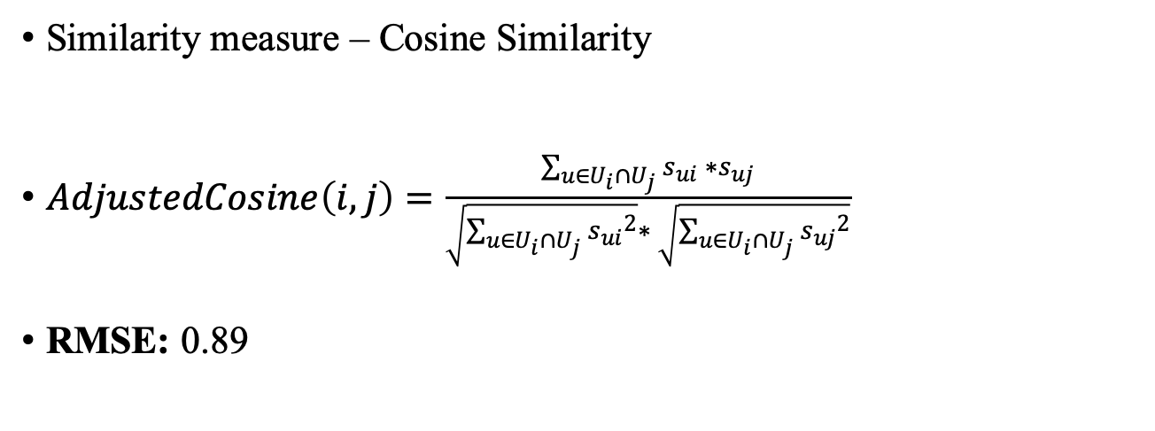
2nd Case – Item-based c.f.
Similarity measure – Cosine Similarity
$AdjustedCosine\left(i, j\right)=\frac{\sum_{u∈U_{i}∩U_{j}}{s_{ui} ∗s_{uj}}}{\sqrt{\sum_{u∈U_{i}∩U_{j}}{{s_{ui}}^{2}}}∗ \sqrt{\sum_{u∈U_{i}∩U_{j}}{{s_{uj}}^{2}}}}$
RMSE: 0.89

Slide 10

3rd Case - SVD
SVD Formula
$M=U∗Σ∗V^{T}$
RMSE: 0.92

Slide 11

4th Case – Content based filtering
TF-IDF Vectorization
${tfidf}_{i, j}= {tf}_{i, j}∗\log\left(\frac{N}{{df}_{i}}\right)$
Accuracy: 0.89, F1: 0.94

Slide 12
Final results
Technique | RMSE | F1
User-based c.f. | 1.09 | -
Item-based c.f. | 0.89 | -
SVD | 0.92 | -
Content-based c.f. | - | 0.94

Slide 13
Conclusion
Best results in term of efficiency, speed and time complexity – Matrix Factorization
Best for Cold starts - Content-based

